Slide 1

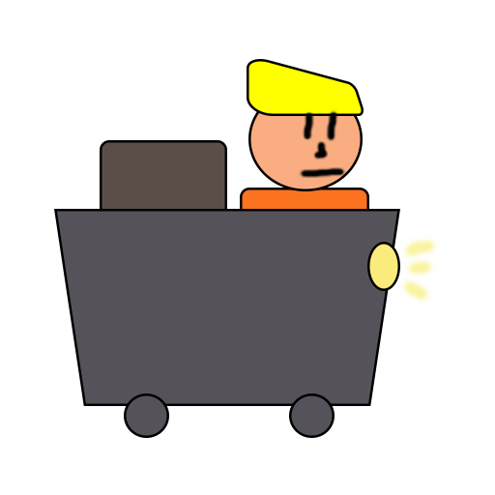
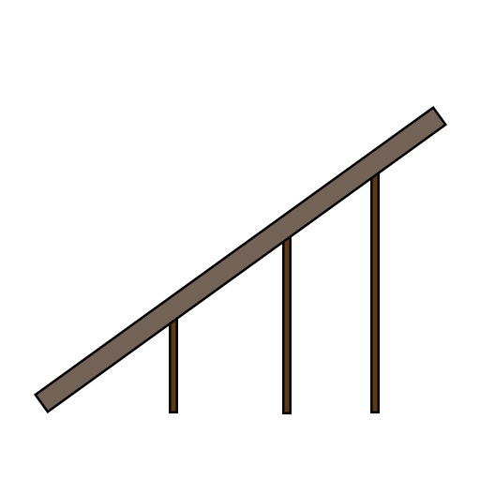
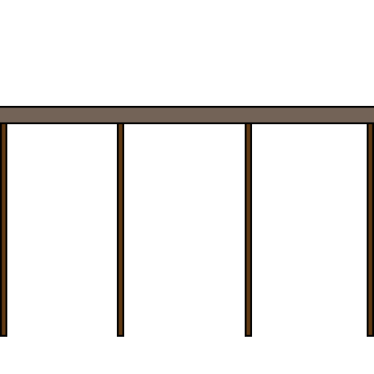
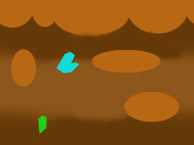
Minecart
Andrei Dumbravescu
Alpeche Pancha
Matthew Fisher

Slide 2

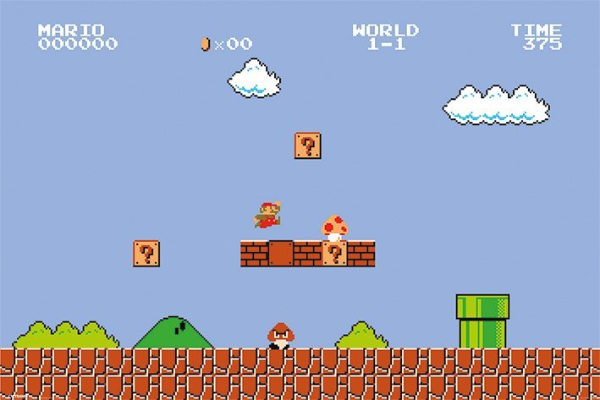
Project Brief
2D Platformer game
Replacing the Jump Mechanic with a Drag and Drop Mechanic
Player needs to have quick reaction and fast decision making

Slide 3
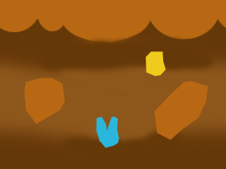
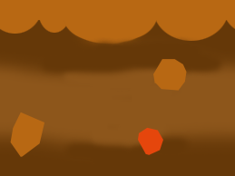

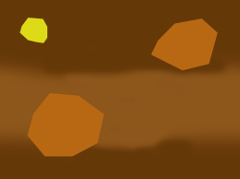
Game Loop
Minecart moves at a constant speed in a random generated level
Player places tracks on the level to avoid obstacles
The game is endless until the minecart hits an obstacle

Slide 4

Emotions
Fiero!
Building tension through constant need of fast reactions and unknowable upcoming obstacles
Release through the inevitable player death

Slide 5
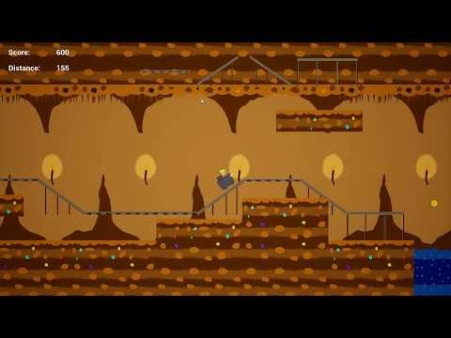
Demo
https://youtu.be/otWon8BLhx8

Slide 6

Upcoming
Random generated assets in the level
Distance tracker
Currency and distance marker assets
UI assets that improve the user experience
Menu screen, pause screen and end screen
Audio
Animations
Visual effects

Slide 7

Questions?

